Slide 1
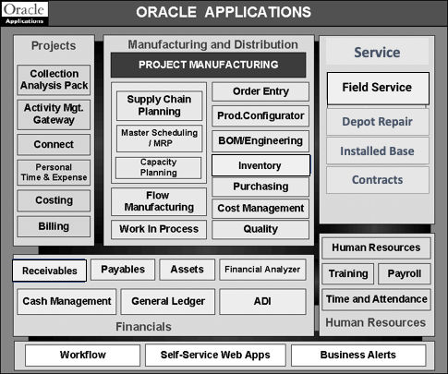
Instructions: Research three modules that would lead to process improvement / elimination of defects and include an explanation of why that capability would solve the business problem identified in task 2.
Business Problem Statement identified in Task 2: Improving service quality by minimizing errors.
Order Management:
In the task 2, we saw that Site Manager was unable to store the exact information needed for the repair. Hence, this software will help in efficiently taking the order as well as storing the details of the repair also.
Workforce Management:
One major problem was the technicians were not available for the repairs as well as the manager was also not informed about their absence, so this help to manage all the technicians essential data.
Inventory Management:
The time delays in the process of repair was a big problem as the warehouse was unaware of the inventory and this added quite a time delay, this software will help by telling us the real time inventory data and also inform when some parts are low so that we can reorder them.
Circle the modules you have selected on this diagram

